Slide 1
Baterista

Slide 2
Baterista - Description & Pedagogy
The word “Baterista is Portuguese for “drummer”. This is a fun song with a catchy groove that eventually evolves into a “samba” rhythm from Brazil.
The snares demonstrate accents and taps with a sixteenth note base, and also play on their neighbors’ drums. The tenors play sixteenth note accents and demonstrate cross-overs. The mallets are modulating between C-major & A-minor, and join the tenors in the main sixteenth note syncopated melody.

Slide 3
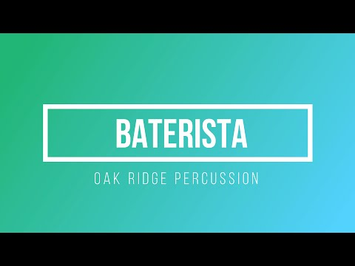
Baterista - Description & Pedagogy

Slide 4
Score and Parts - File Download
https://oakridgepercussionca.files.wordpress.com/2020/11/baterista-score-and-parts.pdf

Slide 5
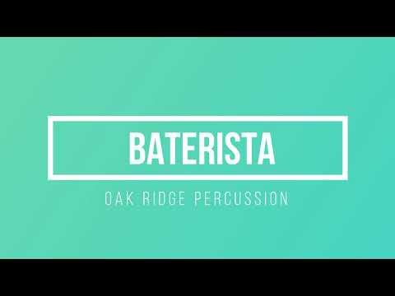
Baterista - Snare Play-a-long Track

Slide 6
Baterista - Tenor Play-a-long Track

Slide 7
Baterista - Pitched Percussion Play-a-long Track

Slide 8
Lesson Plan
https://docs.google.com/document/d/1-FJRXKdiPc1v244EEw0_EVFLw8_paUqi/edit

